Slide 1

Computer Graphics
CS C 471 and IS C 471
Dr. Lucy J. Gudino
Computer Science & Information Systems Group
Birla Institute of Technology & Science, Pilani, Goa Campus

Slide 2
3D Modeling
is the process of developing a mathematical representation of any three-dimensional surface of object via specialized software.
Need for wide variety of representation models
Various Techniques:
  Polygonal surfaces and quadrics
  Spline surfaces
  Volumetric models
  Solid modeling (boundary B-Rep, spatial division Octrees )
  Procedural models (fractals, particle systems,…)
  Physic based modeling

Slide 3

Planar surface modeling
Wireframe modeling:
  Elements: points, lines, arcs and circles, conic and curves
  Advantages: easy to build, low memory requirements and storage

Slide 4
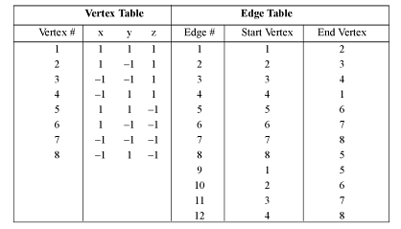
Example : Cube

Slide 5
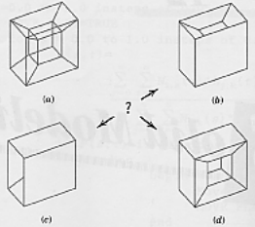
Contd…
  Disadvantages:
    ambiguous representation (hidden-lines removal algorithms)
    lack of visual coherence

Slide 6
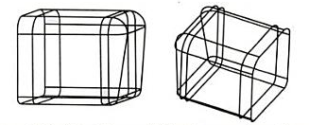
Contd…

Slide 7
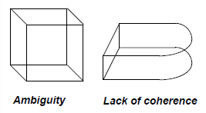
Contd…

Slide 8
Planar surface modeling
Polygonal Modeling
Polygon mesh: vertex, edges and polygon collection where each edge is shared by two polygons as maximum
  vertex: point with coordinates (x,y,z)
  edge: line segment that joins two vertices
  polygon: close sequence of edges

Slide 9
contd…
There are different type of representation that can be used at the same time in a same application
  Explicit
  Pointers to list of vertices
  Pointers to list of edges
Criteria to evaluate different representations:
  time
  space
  topological information

Slide 10
Planar surface modeling
Explicit representation
  Each polygon is represented by a list of vertex coordinates
  p = ((x1,y1,z1), (x2,y2,z2),…..)
Vertices are stored in order (clockwise or counter-clockwise)
Shared vertices are duplicated
There is no explicit representation for shared vertices and edges

Slide 11
Contd…
Advantages:
  Efficient representation for individual polygons
Problems:
  High storage cost
  In order to move a vertex, it is necessary to traverse all the polygons
  If the edges are drawn, the shared ones are drawn twice

Slide 12
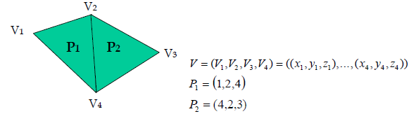
Planar surface modeling
Pointers to list of vertices
  Each vertex is stored once in a list
  A polygon is defined as a list of indexes (or pointers) to the list of vertices

Slide 13
contd…
Advantages
  Each vertex is stored just once
  Coordinates of vertices can be easily changed
Problems
  Difficult to find polygons that share an edge
  Shared edges are still drawn twice

Slide 14
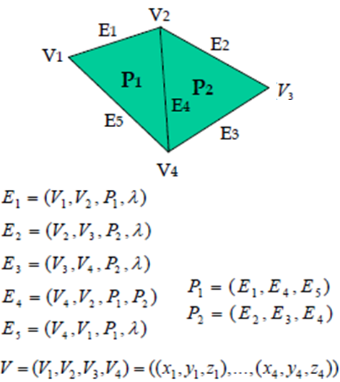
Planar surface modeling
Pointers to list of edges
  Again a list of vertices
  A polygon is represented as a list of indexes to a list of edges
  – Each edge points to two vertices and to the polygons it belongs to

Slide 15
Contd…
Advantages
  Each vertex is stored just once
  The shared edges are drawn just once
Problem
  Difficult to determine which edges share a vertex

Slide 16
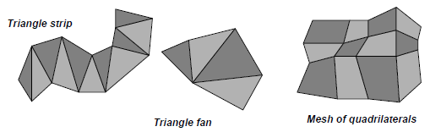
Planar surface modeling
Polygonal meshes
  Triangle strip
    For n vertices, produces (n-2) connected triangles
  Triangle fan
    For n vertices, produces (n-2) connected triangles
  Mesh of quadrilaterals
    Generates a mesh of (n-1) times (m-1) quadrilaterals for n times m vertices

Slide 17
Solid modeling

Slide 18
Solid Modeling
consistent set of principles for mathematical and computer modeling of three dimensional solids.
Solid modeling is based on complete, valid and unambiguous geometric representation of physical object.
  Complete → points in space can be classified. (inside/ outside)
  Valid →vertices, edges, faces are connected properly.
  Unambiguous → there can only be one interpretation of object

Slide 19
Contd..
  Unique: if it can be used to encode any given solid in only one way
  Accurate: allows an object to be represented without approximation
  A representation should allow the use of efficient algorithms for computing desired physical properties
  Objects should maintain closure under rotation , translation and other operations
    Performing these operations on solids should yield valid solids

Slide 20
Solid Modeling
Analysis, automation and integration is possible only with solid models→ has properties such as weight, moment of inertia, mass.
Solid model consist of geometric and topological data
  Geometry → Actual dimensions :length of edges, angles between the edges, radius and location of center
  Topology →
    The topology of an object defines the connectivity and associativity of the entities

Slide 21
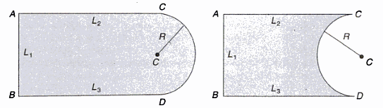
Same geometry but different topology

Slide 22
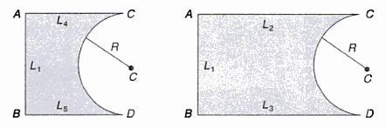
Same topology but different geometry

Slide 23
Solid Modeling
Methods:
  Extrusion
  Constructive solid geometry (CSG)
  Boundary representation (B-rep)
  Spatial enumeration
  Instantiation.

Slide 24

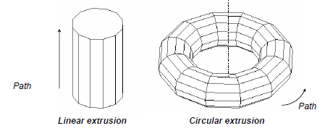
Extrusion
Useful representation in order to build object with rotational or translational symmetries and others
Objects are defined with a 2D primitive and a path in 3D space

Slide 25
Constructive solid geometry (CSG)
Objects are represented as a combination of simpler solid objects (primitives).
The primitives are such as cube, cylinder, cone, torus, sphere etc.
Copies or “instances” of these primitive shapes are created and positioned.
A complete solid model is constructed by combining these “instances” using set specific, logic operations (Boolean)

Slide 26
Constructive solid geometry (CSG)
Boolean operation
  each primitive solid is assumed to be a set of points, a Boolean operation is performed on point sets and the result is a solid model.
  Boolean operation → union, intersection and difference
  The relative location and orientation of the two primitives have to be defined before the Boolean operation can be performed.

Slide 27
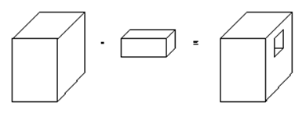
Example

Slide 28
Constructive solid geometry (CSG)- boolean operation
Union
  The sum of all points in each of two defined sets. (logical “OR”)
  Also referred to as Add, Combine, Join, Merge
A
B
A ∪ B

Slide 29
Constructive solid geometry (CSG)- boolean operation
Difference
  The points in a source set minus the points common to a second set. (logical “NOT”)
  Set must share common volume
  Also referred to as subtraction, remove, cut
A
B
A - B

Slide 30
Constructive solid geometry (CSG)- boolean operation
intersection
  Those points common to each of two defined sets (logical “AND”)
  Set must share common volume
  Also referred to as common, conjoin
A
B
A ∩ B

Slide 31
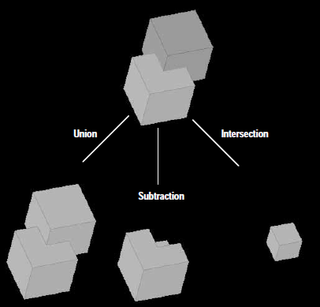

Slide 32
Constructive solid geometry (CSG)- boolean operation
When using Boolean operation, be careful to avoid situation that do not result in a valid solid
Intersection may yield a solid, a plane, a line, a point or a null set
A
B
A ∩ B

Slide 33
Constructive solid geometry (CSG)- boolean operation
Boolean operation
  Are easy to use and understand
  Provide for the rapid manipulation of large amounts of data.
Because of this, many non-CSG systems also use Boolean operations

Slide 34
Constructive solid geometry (CSG)- data structure
Data structure does not define model shape explicitly but rather implies the geometric shape through a procedural description
  E.g: object is not defined as a set of edges & faces but by the instruction : union primitive1 with primitive 2
This procedural data is stored in a data structure referred to as a CSG tree
The data structure is simple and stores compact data → easy to manage

Slide 35
Constructive solid geometry (CSG)- CSG tree
CSG tree → stores the history of applying boolean operations on the primitives.
  Stores in a binary tree format
  The outer leaf nodes of tree represent the primitives
  The interior nodes represent the boolean operations performed.

Slide 36
Constructive solid geometry (CSG)- CSG tree
+
-

Slide 37
Constructive solid geometry (CSG)- not unique
More than one procedure (and hence database) can be used to arrive at the same geometry.
∪
-

Slide 38
Constructive solid geometry (CSG) representation
CSG representation is unevaluated
  Faces, edges, vertices not defined in explicit
CSG model are always valid
  Since built from solid elements.
CSG models are complete and unambiguous

Slide 39
Constructive solid geometry (CSG) - advantage
CSG is powerful with high level command.
Easy to construct a solid model – minimum step.
CSG modeling techniques lead to a concise database→ less storage.
  Complete history of model is retained and can be altered at any point.

Slide 40
Constructive solid geometry (CSG) - disadvantage
Only boolean operations are allowed in the modeling process
  with boolean operation alone, the range of shapes to be modeled is severely restricted
  not possible to construct unusual shape.
Requires a great deal of computation to derive the information on the boundary, faces and edges which is important for the interactive display/ manipulation of solid.

